Slide 1
Brew Monday 2023
Tea party games pack
For virtual or in-person events
Notes:
Whether you’re planning to hold a Brew Monday event online or in person, we have created a few tea-themed games to encourage people at your event to connect over a cuppa. Hopefully you’ll be able to use and adapt some of the ideas shared in this presentation to create a successful tea party event of your own.

Slide 2
Table of contents
Introduction
About Brew Monday 2023
Brew Monday 5,4,3,2,1
Brew Monday: Share a memory
Get art-tea
Brew Monday tea quiz
Brew Monday bingo
Downloadable activities
Raising money for Samaritans

Slide 3
Introduction
Welcome to our Brew Monday event package!
We’ve put together some brew-illiant games and other ideas to help you organise your best ever Brew Monday event.
From ice breakers to art challenges and silly word games, there are lots of activities to choose from. Hopefully you’ll find something that will make your event fa-brew-lous.
Make Brew Monday your own by using the games and resources that work best for your event.
And remember – you can have a Brew Monday on any day
of the year!
Let’s brew this!
PS If you have any questions, you can reach us at marketing@samaritans.org

Slide 4
Brew Monday 2023
This Brew Monday, 16 January, Samaritans is reminding everyone to reach out for a cuppa and a catch-up with
the people you care about.
At Samaritans we know there’s no such thing as ‘Blue Monday’ – feeling low isn’t just something that happens
on Mondays or in January.
So we say out with the blue and in with the brew!
There’s always time for a cuppa and a catch-up. It doesn’t matter if it’s a Monday morning or Saturday night, or if you’re drinking green tea, black coffee or orange juice.
If you’re sharing a cuppa and listening, you’re doing it right!

Slide 5
Brew Monday 5, 4, 3, 2, 1
Which of these apply to you?
I have warmed up a cold cup of tea in a microwave
I have put cold tea bags on my eyes
I put the tea bag and milk in a cup before adding boiling water
I have tipped away a badly made cup of tea
I only drink one brand of tea
I prefer tea with lemon
I have never had a cup of tea
I have had a cup of tea brought to me in bed
I drink more than 4 cups of tea a day
I always pack tea bags to take with me on holiday
Notes:
How to play: Ask everyone in the room or on screen to hold up five fingers on one hand.
Then read out a series of statements like the ones here - participants have to fold a finger down each time they have done one of the things read out loud. The winner is the person at the end of the round who is still ‘in’ or who has the most fingers remaining.

Slide 6
Brew Monday:
Share a memory
1. Split into pairs (if virtually use breakout rooms)
2. Each person takes it in turns to share a memory about:
- Their favourite cup of tea
- The person they would most like to share a cuppa
with and why
3. After 5 minutes, come back together as a group and take it in turns to share your partner’s memories with the group.
For example: 'This is *name* and their favourite
memory was xxx because xxx.
Notes:
This activity is designed to help people make the time to get to know and listen to each other.

Slide 7
Get art-tea!
Divide into pairs.
Make sure you have to hand a piece of paper and a pen or pencil.
Ask the other person to describe their favourite cuppa, a place they love, someone who makes them smile and something they do that makes them happy.
While you’re talking, draw the other person enjoying a cuppa in their favourite place, with the person and things that make them happy. Ask questions as you go along to add more details to your drawing.
After a few minutes, share the portraits with each other. Do you recognise what you described?
Notes:
This is a great ice breaker and encourages people to get to know each other, and gives them a focus for a conversation which will naturally follow when they reveal their portraits.

Slide 8
Brew Monday tea quiz
Test your knowledge with our Brew Monday tea trivia!
1. What per cent of the British population drink tea and herbal infusions every day?
A) 84% B) 50% C) 39%
2. How many cups of tea do Britain’s drink per year?
A) 1.6 million cups
B) 36 billion cups
C) 84 billion cups
3. 98% of people take their
tea with milk, but what per
cent takes sugar?
A) 15% B) 30% C) 60%
4. Globally, how many tons of
tea is produced every year?
A) 1.6 billion tons
B) 750,000 tons
C) 2.9 million tons
Notes:
Answer key:
A) 84%
B) 36 billion cups
B) 30%
C) 2.9 million tons
C) 1,500
A) Darjeeling tea
C) 2,000
B) 4
A)True

Slide 9
Brew Monday tea quiz
5. Approximately, how many known varieties of tea are there?
A) 987 B) 3,000 C) 1,500
6. What tea is referred to as the ‘Champagne of teas’ and is largely only grown in a 70 square mile area at the foot of the Himalayas?
A) Darjeeling tea
B) Oolong tea
C) Assam tea
7. How many tea leaves does
it take to create one pound of finished black tea ?
A) 5,000 B) 10,000 C) 2,000
8. What is the number of recommended cups of tea to drink every day?
A) 6 B) 4 C) 2
9. Tea is a natural source of fluoride that can help protect against tooth decay.
A) True B) False
Notes:
Answer key:
A) 84%
B) 36 billion cups
B) 30%
C) 2.9 million tons
C) 1,500
A) Darjeeling tea
C) 2,000
B) 4
A)True

Slide 10
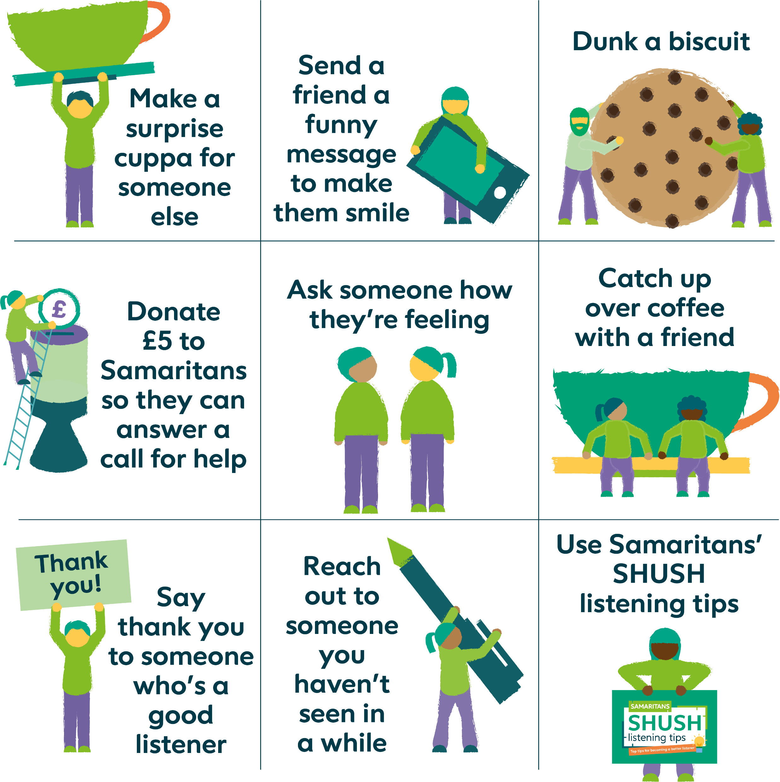
Brew Monday bingo
How many of these can you cross off today?
Notes:
Make the Brew Monday ‘glow’ last all day by encouraging people to play ‘Brew Monday bingo’ and see how many of these activities they can cross off the list.

Slide 11
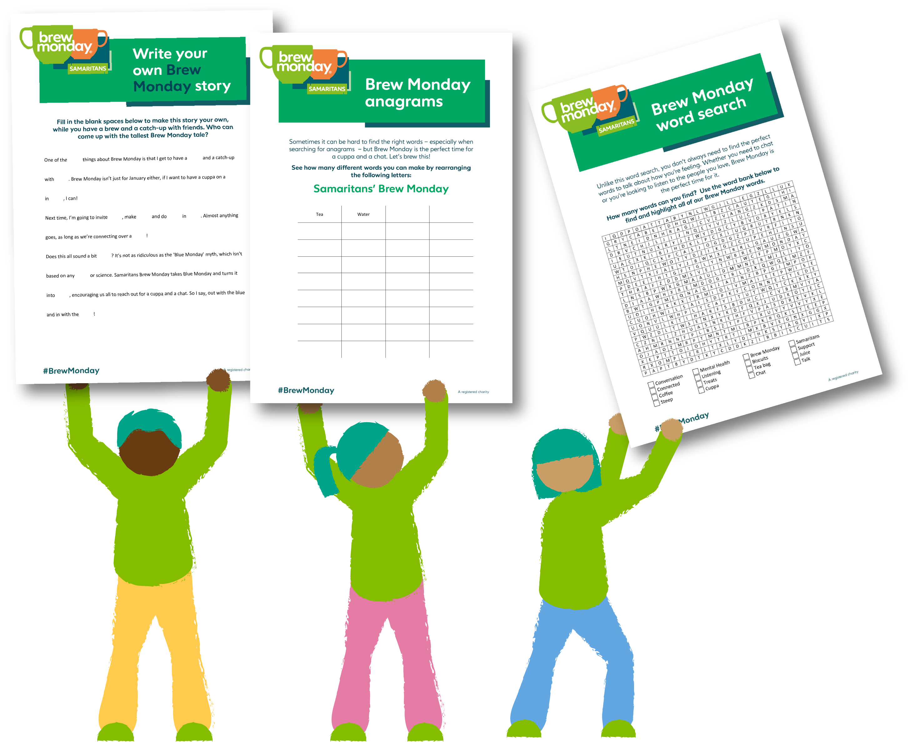

Downloadable activities
Still looking for more activities to make your Brew Monday the best ever?
We have some tea-rrific downloadable activity sheets on our website.
Try our Brew Monday anagram, do a Brew Monday word search or write your own silly Brew Monday story.
Visit our downloadable Brew
Monday resources page for
all of this and more.

Slide 12
Help us be there when it matters most
By giving a donation or fundraising for Samaritans on Brew Monday, you’ll help make sure there’s always someone there for anyone who’s going through a tough time.
£5 is all it takes to cover the costs of Samaritans answering a call for help.
The quickest and easiest way to give a donation is online at: samaritans.org/brew-fundraising
Or you can simply text BREW to 70450 to make a
£5 donation. You will be charged £5, plus one message at your standard network rate. Samaritans will receive 100% of your donation.
Notes:
Feel free to update this page with your branch donation details!

Slide 13
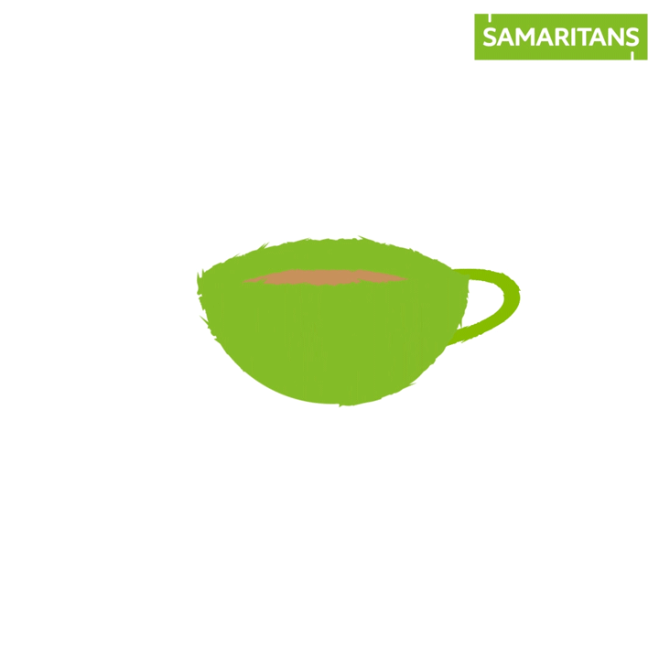
Thank you!
Notes:
Thank you for connecting over a cuppa and supporting Samaritans!

